Slide 1
Neural network modeling of the flow stress of the AlMg6/10% SiC metal matrix composite under deformation at high temperatures
Institute of Engineering Science, Ural Branch of the Russian Academy of Sciences
Нейросетевое моделирование сопротивления деформации металломатричного композита АМг6/10% SiC в условиях высоких температур деформаций
V.S. Kanakin, A.S. Smirnov, A.V. Konovalov
2021

Slide 2
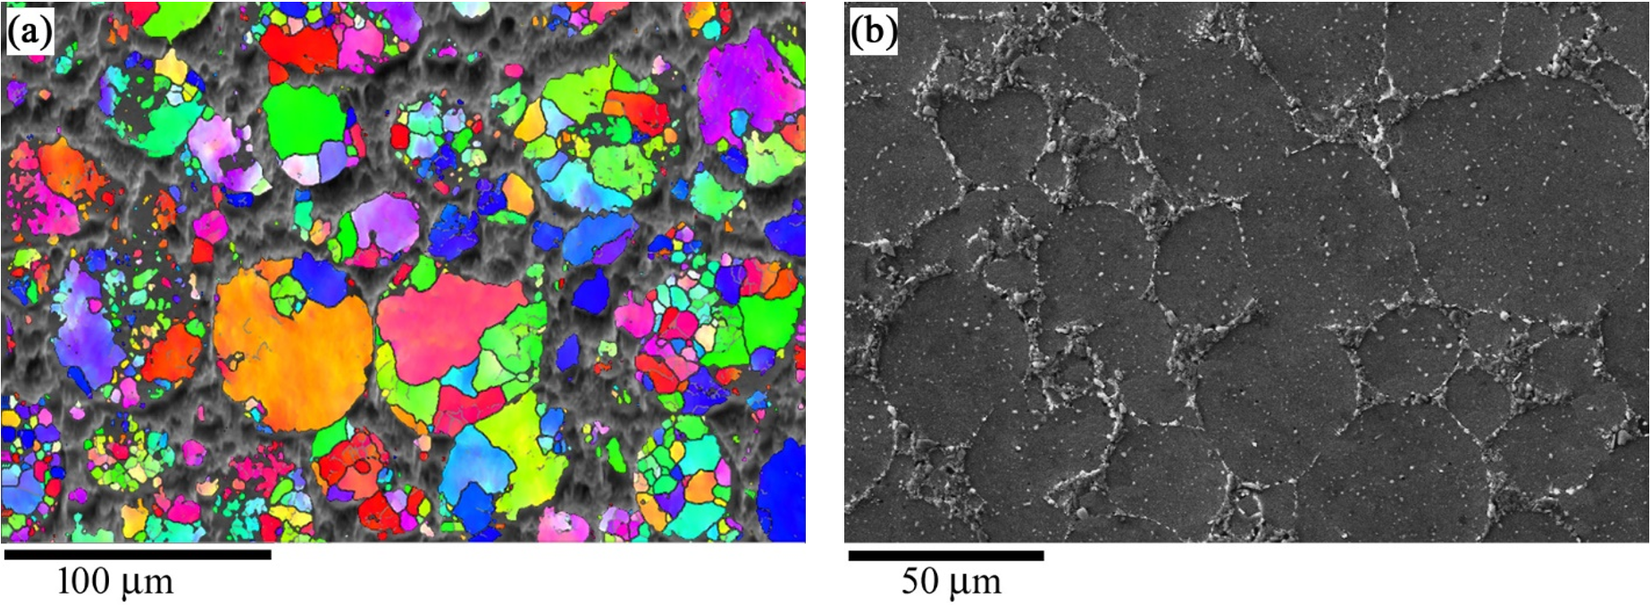
Neural network modeling of the flow stress of the AlMg6/10% SiC metal matrix composite under deformation at high temperatures
V.S. Kanakin, A.S. Smirnov, A.V. Konovalov
The purpose of this work is to build a neural network for describing and predicting the flow stress of the AlMg6/10% SiC metal matrix composite at deformation temperatures ranging from 300 to 500 °С.
Table 1 – Chemical composition of the alloy AMg6
Element | Al | Mg | Mn | Fe | Si | Cu | Ti | Zn | Be
Content, % | 92,4 | 6,56 | 0,5 | 0,27 | 0,16 | 0,013 | 0,04 | 0,02 | 0,0012
F
9 mm
Fig. 1. An EBSD image (a) and a SEM image (b) of the microstructure of the AlMg6/10% SiC metal matrix composite.
F
6 mm
2

Slide 3
Neural network modeling of the flow stress of the AlMg6/10% SiC metal matrix composite under deformation at high temperatures
V.S. Kanakin, A.S. Smirnov, A.V. Konovalov
The rheological behavior of the composite and its modeling
Fig 2. – The strain and strain rate dependence of flow stress for the AlMg6/10% SiC MMC plotted from the results of experiments at deformation temperatures of 300 (a), 400 (b), and 500 °С (c)
3

Slide 4
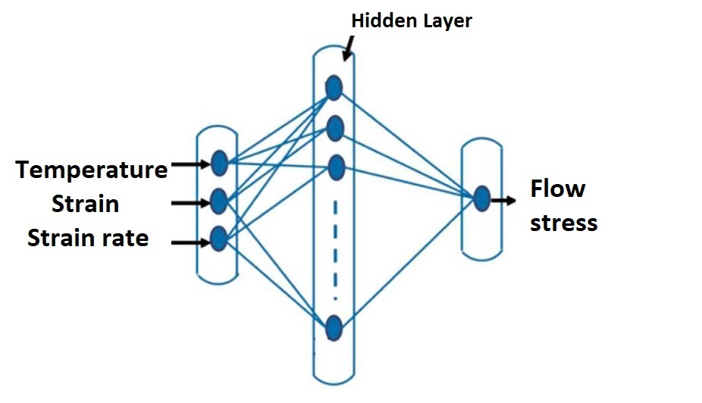
Neural network modeling of the flow stress of the AlMg6/10% SiC metal matrix composite under deformation at high temperatures
V.S. Kanakin, A.S. Smirnov, A.V. Konovalov
The rheological behavior of the composite and its modeling
The average relative deviation Δ:
The coefficient of variation δ:
Fig. 3. The neural network diagram used to describe the rheological behavior of the MMC AlMg6/10%SiC
N is the total number of points used in the identification (verification) of the neural network; $σ_{i}$ and $z_{i}$ are the calculated flow stress and that used in the identification (verification) of the neural network, respectively; S(σ) is the standard deviation of the experimentally obtained flow stress values from those described by the neural network.
4

Slide 5
Neural network modeling of the flow stress of the AlMg6/10% SiC metal matrix composite under deformation at high temperatures
V.S. Kanakin, A.S. Smirnov, A.V. Konovalov
The rheological behavior of the composite and its modeling
300, 400, 500 °С
350, 450 °С
Identification
Verification
Fig. 4. The influence of the number of neurons on the average relative deviation Δ and the coefficient of variation δ during identification (a) and verification (b) of the neural network.
Table 2 – Neural network architecture
Parameters | Значение
Learning algorithm | Backpropagation
Number of neurons | 200
Number of epochs | 10000
Activation function | logistic
Learning rate | 0,001
Number of hidden layers | 1
5

Slide 6
Neural network modeling of the flow stress of the AlMg6/10% SiC metal matrix composite under deformation at high temperatures
V.S. Kanakin, A.S. Smirnov, A.V. Konovalov
The rheological behavior of the composite and its modeling
Fig. 5. The strain and strain rate dependence of flow stress for the AlMg6/10% SiC MMC plotted from the results of experiments (black curve) and their approximation by the neural network with 200 neurons (red curve) at deformation temperatures of 300 (a), 400 (b), and 500 °С (c)
Fig. 6. The strain and strain rate dependences of flow stress for the AlMg6/10% SiC MMC at 350 °С (a) and 450 °С (b): experimental (black curve) and predicted by the neural network (red curve)
6

Slide 7
Neural network modeling of the flow stress of the AlMg6/10% SiC metal matrix composite under deformation at high temperatures
V.S. Kanakin, A.S. Smirnov, A.V. Konovalov
Conclusions
1. The obtained experimental flow stress curves of the AlMg6/10% SiC metal matrix composite at temperatures ranging from 300 to 500 °С and strain rates range from 0.1 to 5 s⁻¹ indicate dynamic recrystallization, which causes the appearance of peaks on the flow stress curves in the entire temperature–rate range under study.
2. It has been shown that the constructed neural network can predict the rheological behavior of the AlMg6/10% SiC metal matrix composite at temperatures ranging from 300 to 500 °С and strain rates of 0.1 to 5 s⁻¹ with acceptable engineering accuracy.
7

Slide 8
Thank you for your attention!
Neural network modeling of the flow stress of the AlMg6/10% SiC metal matrix composite under deformation at high temperatures
V.S. Kanakin, A.S. Smirnov, A.V. Konovalov

